Slide 1

Chapter 30
Cryptography
30.<number>
Copyright © The McGraw-Hill Companies, Inc. Permission required for reproduction or display.

Slide 2
30-1 INTRODUCTION
Let us introduce the issues involved in cryptography. First, we need to define some terms; then we give some taxonomies.
Topics discussed in this section:
Definitions
Two Categories
30.<number>

Slide 3
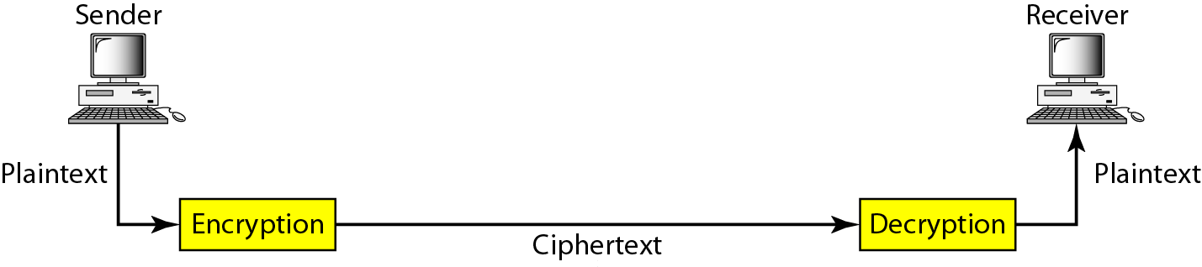
Figure 30.1 Cryptography components
30.<number>

Slide 4
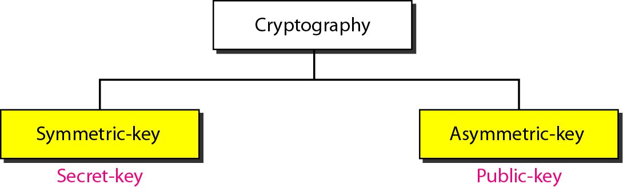
Figure 30.2 Categories of cryptography
30.<number>

Slide 5
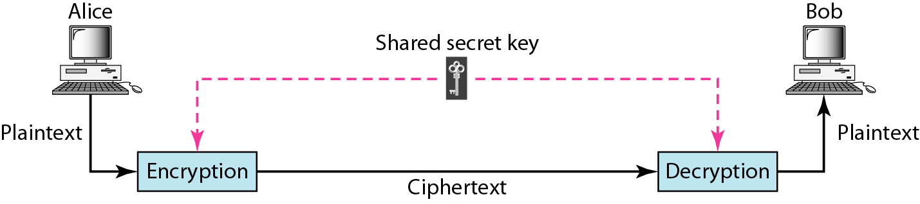
Figure 30.3 Symmetric-key cryptography
30.<number>

Slide 6

Note
In symmetric-key cryptography, the same key is used by the sender
(for encryption)
and the receiver (for decryption).
The key is shared.
30.<number>

Slide 7
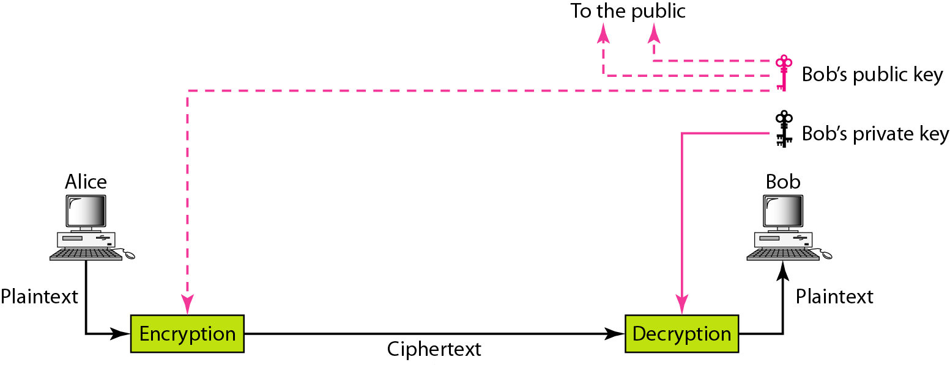
Figure 30.4 Asymmetric-key cryptography
30.<number>

Slide 8
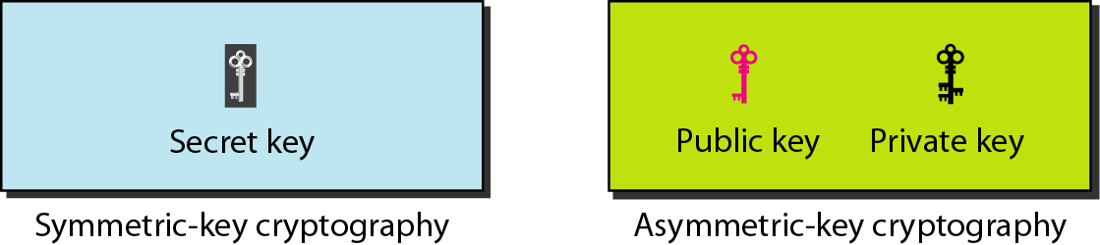
Figure 30.5 Keys used in cryptography
30.<number>

Slide 9
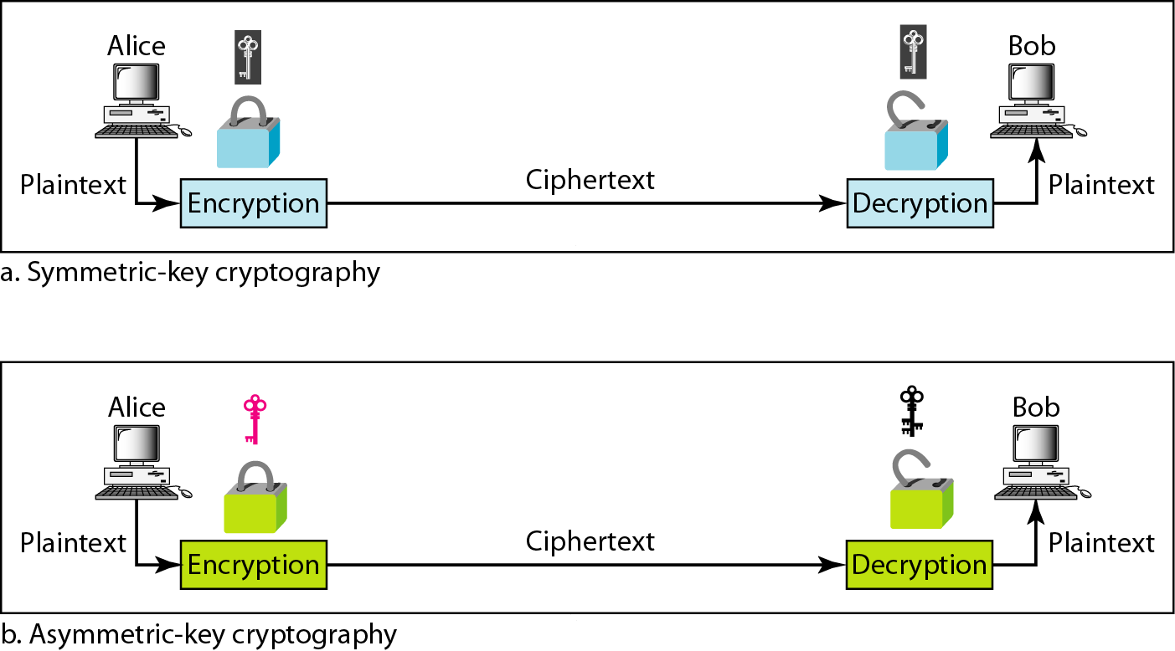
Figure 30.6 Comparison between two categories of cryptography
30.<number>

Slide 10
30-2 SYMMETRIC-KEY CRYPTOGRAPHY
Symmetric-key cryptography started thousands of years ago when people needed to exchange secrets (for example, in a war). We still mainly use symmetric-key cryptography in our network security.
Topics discussed in this section:
Traditional Ciphers
Simple Modern Ciphers
Modern Round Ciphers
Mode of Operation
30.<number>

Slide 11
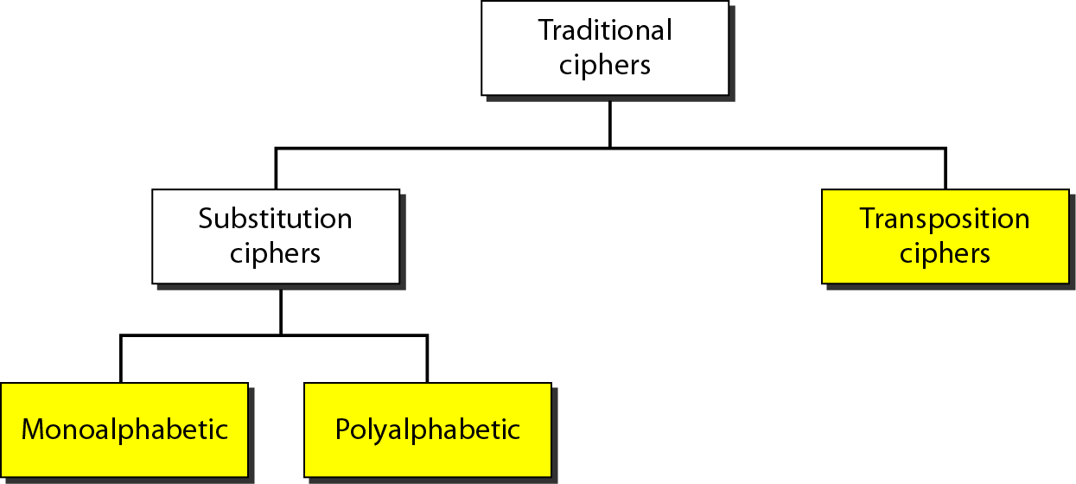
Figure 30.7 Traditional ciphers
30.<number>

Slide 12
Note
A substitution cipher replaces one symbol with another.
30.<number>

Slide 13
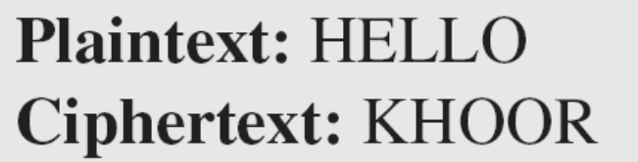
Example 30.1
The following shows a plaintext and its corresponding ciphertext. Is the cipher monoalphabetic?
Solution
The cipher is probably monoalphabetic because both occurrences of L’s are encrypted as O’s.
30.<number>

Slide 14
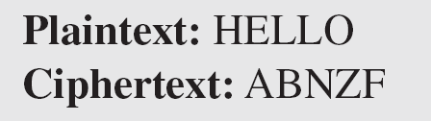
Example 30.2
The following shows a plaintext and its corresponding ciphertext. Is the cipher monoalphabetic?
Solution
The cipher is not monoalphabetic because each occurrence of L is encrypted by a different character. The first L is encrypted as N; the second as Z.
30.<number>

Slide 15
Note
The shift cipher is sometimes referred to as the Caesar cipher.
30.<number>

Slide 16
Example 30.3
Use the shift cipher with key = 15 to encrypt the message “HELLO.”
Solution
We encrypt one character at a time. Each character is shifted 15 characters down. Letter H is encrypted to W. Letter E is encrypted to T. The first L is encrypted to A. The second L is also encrypted to A. And O is encrypted to D. The cipher text is WTAAD.
30.<number>

Slide 17
Example 30.4
Use the shift cipher with key = 15 to decrypt the message “WTAAD.”
Solution
We decrypt one character at a time. Each character is shifted 15 characters up. Letter W is decrypted to H. Letter T is decrypted to E. The first A is decrypted to L. The second A is decrypted to L. And, finally, D is decrypted to O. The plaintext is HELLO.
30.<number>

Slide 18
Note
A transposition cipher reorders (permutes) symbols in a block of symbols.
30.<number>

Slide 19
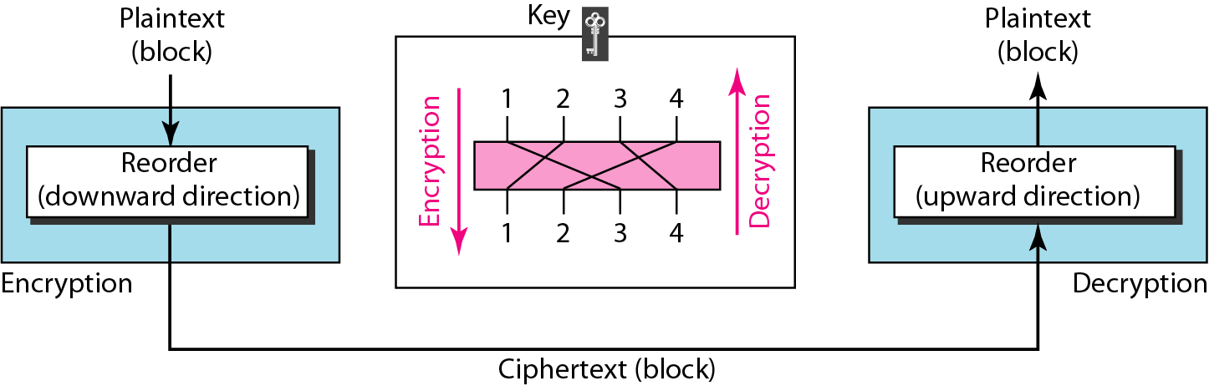
Figure 30.8 Transposition cipher
30.<number>

Slide 20
Example 30.5
Encrypt the message “HELLO MY DEAR,” using the key shown in Figure 30.8.
Solution
We first remove the spaces in the message. We then divide the text into blocks of four characters. We add a bogus character Z at the end of the third block. The result is HELL OMYD EARZ. We create a three-block ciphertext ELHLMDOYAZER.
30.<number>

Slide 21
Example 30.6
Using Example 30.5, decrypt the message “ELHLMDOYAZER”.
Solution
The result is HELL OMYD EARZ. After removing the bogus character and combining the characters, we get the original message “HELLO MY DEAR.”
30.<number>

Slide 22
Simple Modern Ciphers
The traditional ciphers we have studied so far are character-oriented.
With the advent of the computer, ciphers need to be bit-oriented.
This is so because the information to be encrypted is not just text; it can also consist of numbers, graphics, audio, and video data.
It is convenient to convert these types of data into a stream of bits, encrypt the stream, and then send the encrypted stream.
In addition, when text is treated at the bit level, each character is replaced by 8 bits, which means the number of symbols becomes 8.
30.<number>

Slide 23
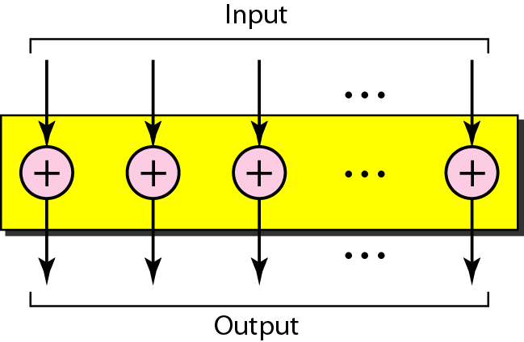
Figure 30.9 XOR cipher
30.<number>

Slide 24
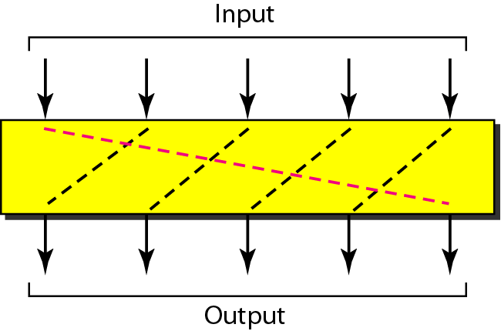
Figure 30.10 Rotation cipher
30.<number>

Slide 25
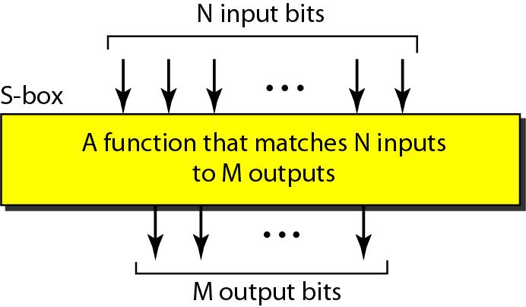
Figure 30.11 S-box
Substitution Cipher
30.<number>

Slide 26
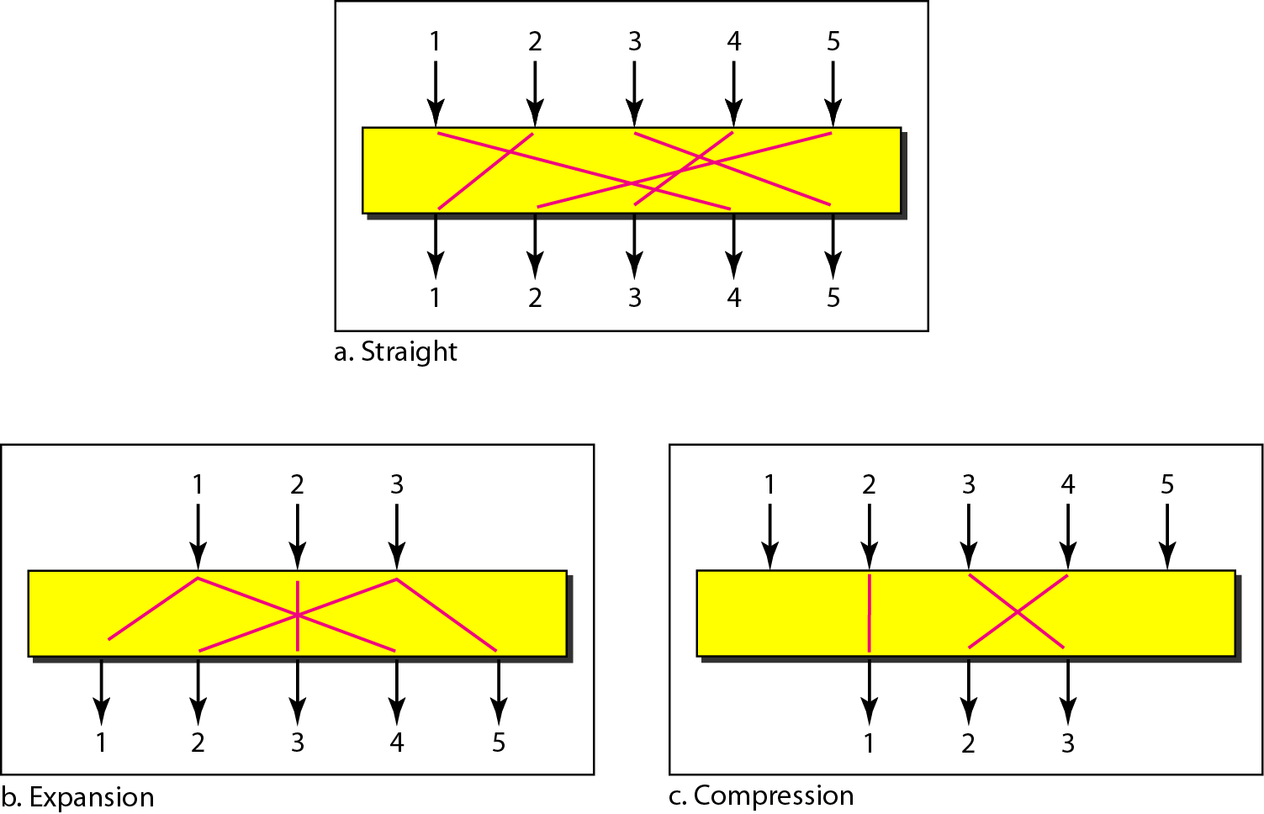
Transposition Cipher
Figure 30.12 P-boxes: straight, expansion, and compression
30.<number>

Slide 27
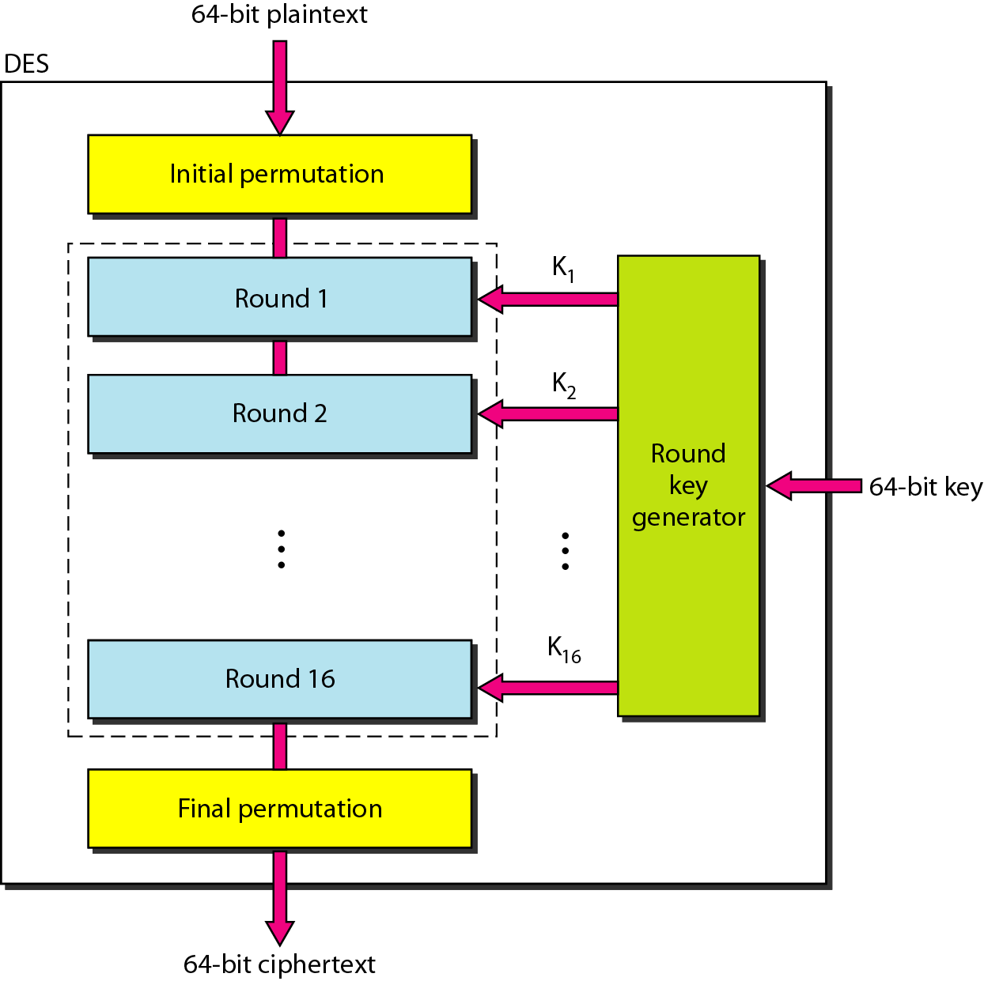
Figure 30.13 DES
30.<number>

Slide 28
Modern Round Ciphers
The ciphers of today are called round ciphers because they involve multiple rounds, where each round is a complex cipher made up of the simple ciphers that we previously described.
The key used in each round is a subset or variation of the general key called the round key. If the cipher has N rounds, a key generator produces N keys, K1, K2, . . ., KN, where K1 is used in round 1, K2 in round 2, and so on
30.<number>

Slide 29
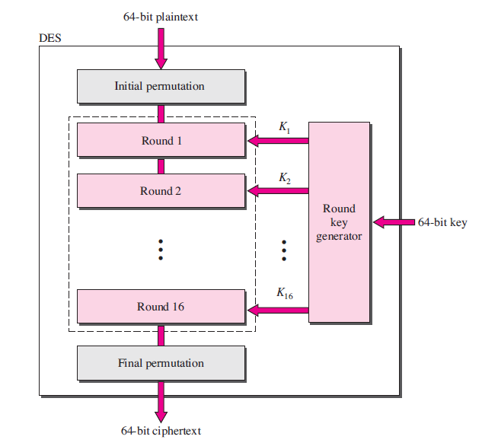
DES cipher
30.<number>

Slide 30
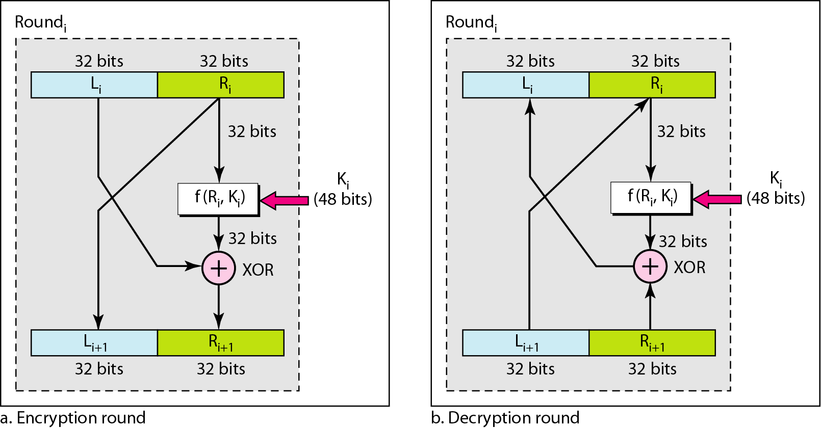
Figure 30.14 One round in DES ciphers
30.<number>

Slide 31
Figure 30.15 DES function
30.<number>

Slide 32
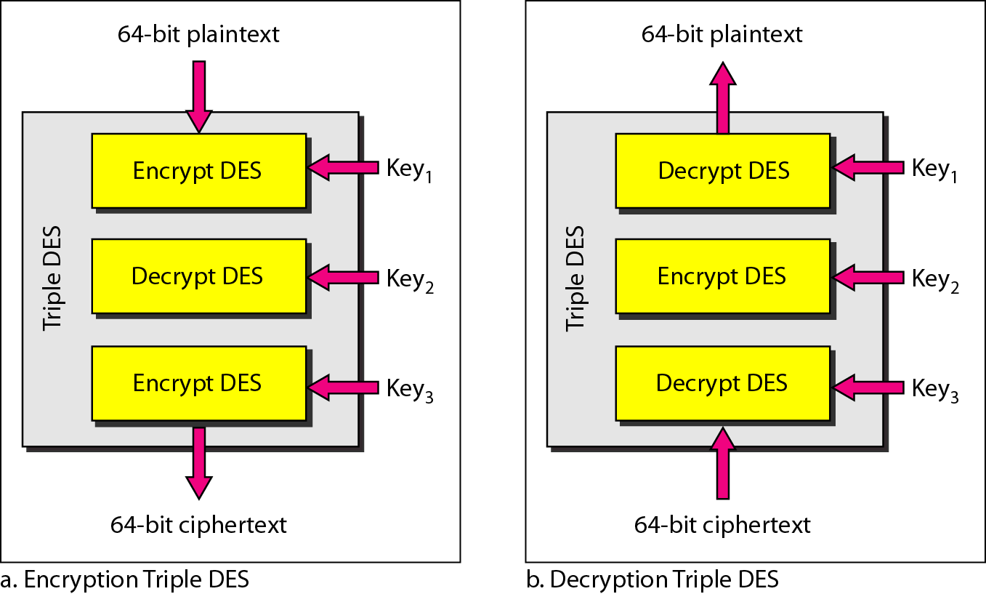
Figure 30.16 Triple DES
30.<number>

Slide 33
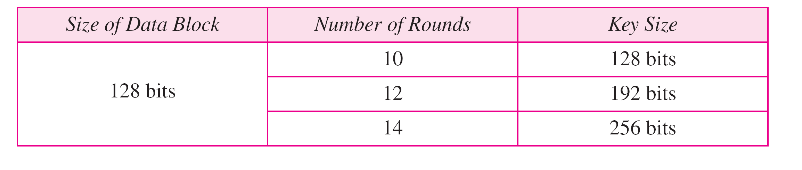
Table 30.1 AES configuration
30.<number>

Slide 34
Note
AES has three different configurations with respect to the number of rounds and key size.
30.<number>

Slide 35
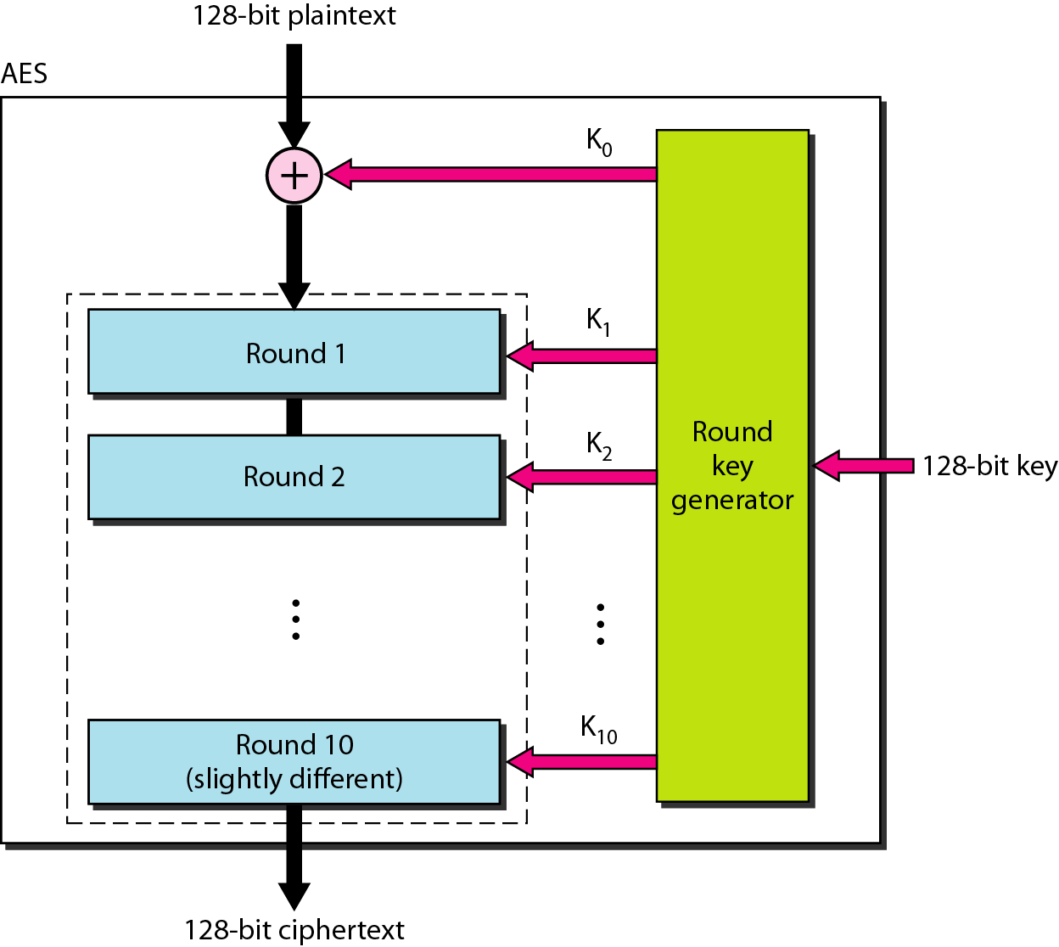
Figure 30.17 AES
30.<number>

Slide 36
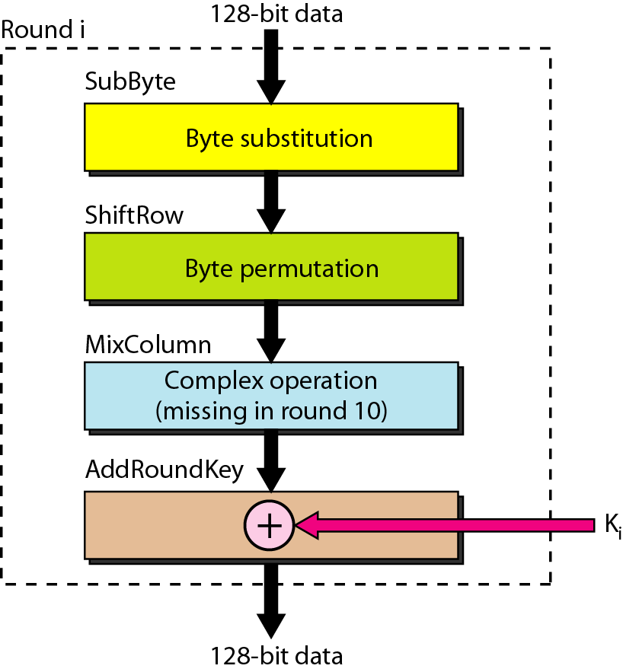
Figure 30.18 Structure of each round
30.<number>

Slide 37
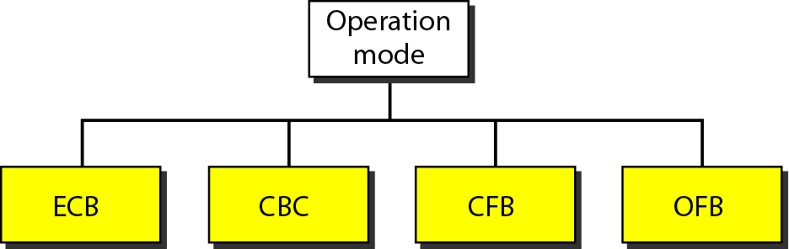
Figure 30.19 Modes of operation for block ciphers
30.<number>

Slide 38
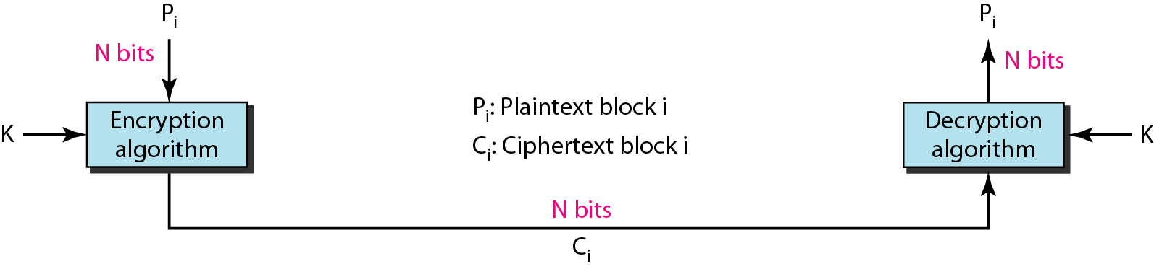
Figure 30.20 ECB mode
30.<number>

Slide 39
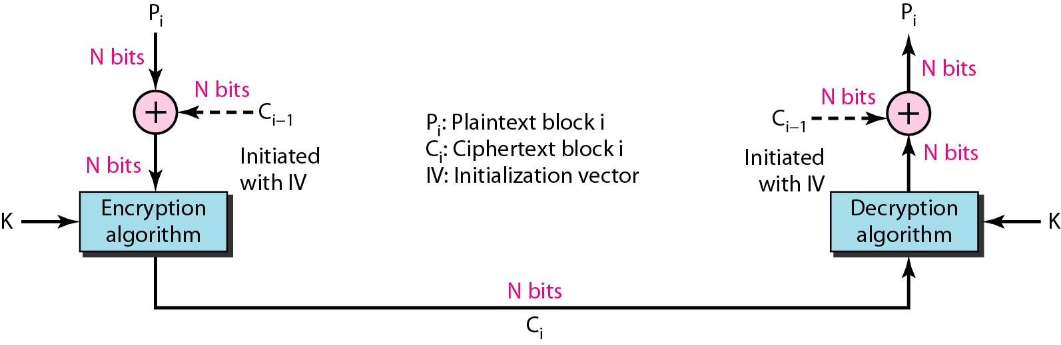
Figure 30.21 CBC mode
30.<number>

Slide 40
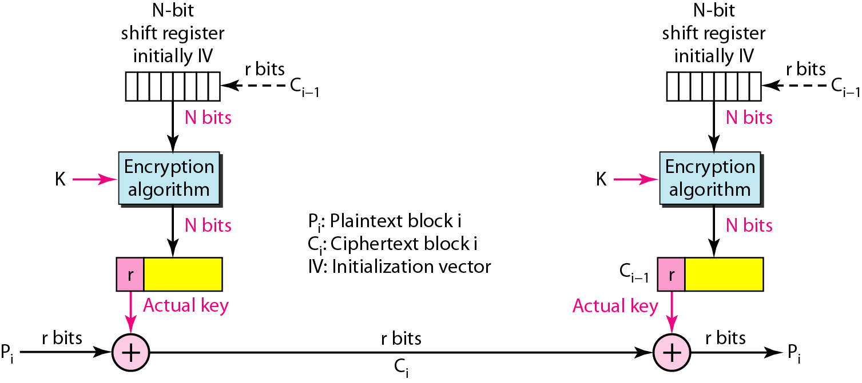
Figure 30.22 CFB mode
30.<number>

Slide 41
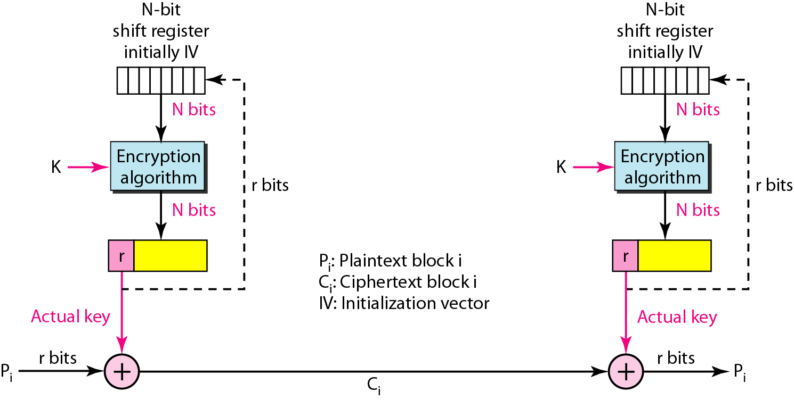
Figure 30.23 OFB mode
30.<number>

Slide 42
30-3 ASYMMETRIC-KEY CRYPTOGRAPHY
An asymmetric-key (or public-key) cipher uses two keys: one private and one public. We discuss two algorithms: RSA and Diffie-Hellman.
Topics discussed in this section:
RSA
Diffie-Hellman
30.<number>

Slide 43
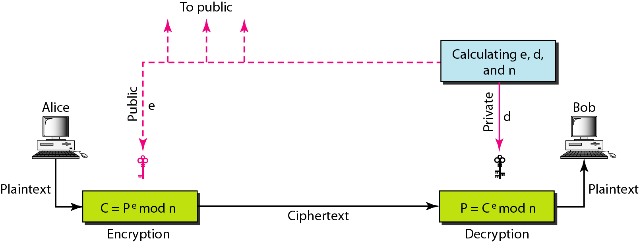
Figure 30.24 RSA
30.<number>

Slide 44
Selecting Keys
Bob use the following steps to select the private and public keys:
1. Bob chooses two very large prime numbers p and q. Remember that a prime number is one that can be divided evenly only by 1 and itself.
2. Bob multiplies the above two primes to find n, the modulus for encryption and decryption. In other words, n = p × q
3. Bob calculates another number φ = (p - 1) × (q - 1)
4. Bob chooses a random integer e. He then calculates d so that d × e = 1 mod φ
5. Bob announces e and n to the public; he keeps φ and d secret.
30.<number>

Slide 45
Encryption
Anyone who needs to send a message to Bob can use n and e. For example, if Alice needs to send a message to Bob, she calculates the ciphertext, using e and n.
C = P^{e} (mod n)
Alice sends C, the ciphertext, to Bob.
Decryption
Bob keeps φ and d private. When he receives the ciphertext, he uses his private key d to decrypt the message :
P = C^{d} (mod n)
Restriction
For RSA to work, the value of P must be less than the value of n. If P is a large number, the plaintext needs to be divided into blocks to make P less than n.
30.<number>

Slide 46
Note
In RSA, e and n are announced to the public; d and Φ are kept secret.
30.<number>

Slide 47
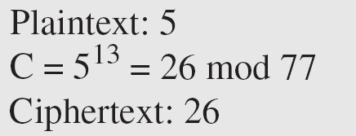
Example 30.7
Bob chooses 7 and 11 as p and q and calculates
n = 7 · 11 = 77. The value of Φ = (7 − 1) (11 − 1) or 60. Now he chooses two keys, e and d. If he chooses e to be 13, then d is 37. Now imagine Alice sends the plaintext 5 to Bob. She uses the public key 13 to encrypt 5.
30.<number>

Slide 48
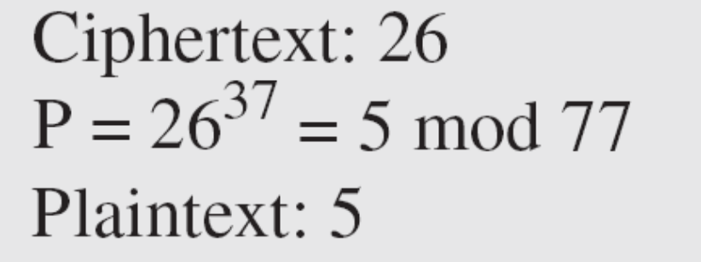
Example 30.7 (continued)
Bob receives the ciphertext 26 and uses the private key 37 to decipher the ciphertext:
The plaintext 5 sent by Alice is received as plaintext 5 by Bob.
30.<number>

Slide 49
Example 30.8
Jennifer creates a pair of keys for herself. She chooses
p = 397 and q = 401. She calculates n = 159,197 and
Φ = 396 · 400 = 158,400. She then chooses e = 343 and
d = 12,007. Show how Ted can send a message to Jennifer if he knows e and n.
30.<number>

Slide 50
Example 30.8 (continuted)
Solution
Suppose Ted wants to send the message “NO” to Jennifer. He changes each character to a number (from 00 to 25) with each character coded as two digits. He then concatenates the two coded characters and gets a four-digit number. The plaintext is 1314. Ted then uses e and n to encrypt the message. The ciphertext is 1314³⁴³ = 33,677 mod 159,197. Jennifer receives the message 33,677 and uses the decryption key d to decipher it as 33,677^{12,007} = 1314 mod 159,197. Jennifer then decodes 1314 as the message “NO”. Figure 30.25 shows the process.
30.<number>

Slide 51
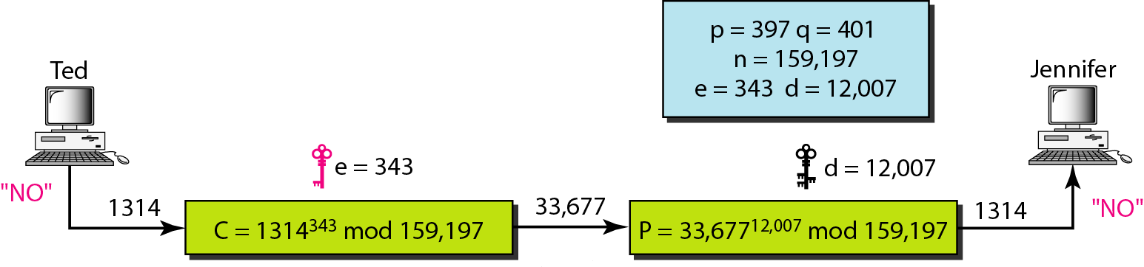
Figure 30.25 Example 30.8
30.<number>

Slide 52
Example 30.9
Let us give a realistic example. We randomly chose an integer of 512 bits. The integer p is a 159-digit number.
The integer q is a 160-digit number.
30.<number>

Slide 53
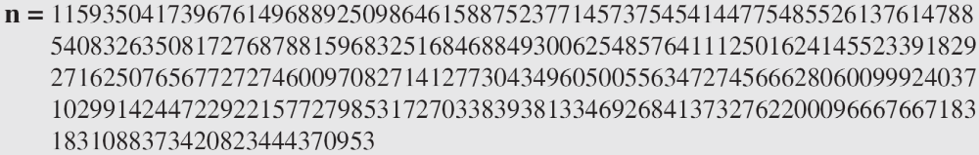
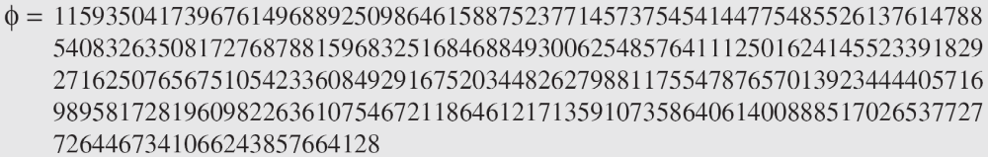
Example 30.9 (continued)
We calculate n. It has 309 digits:
We calculate Φ. It has 309 digits:
30.<number>

Slide 54
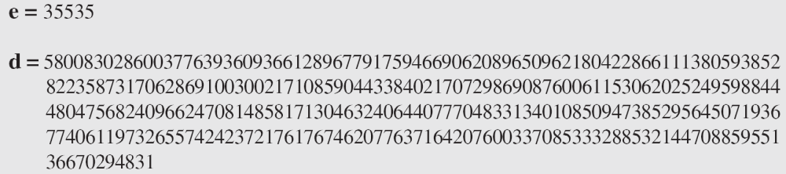
Example 30.9 (continued)
We choose e = 35,535. We then find d.
Alice wants to send the message “THIS IS A TEST” which can be changed to a numeric value by using the 00–26 encoding scheme (26 is the space character).
30.<number>

Slide 55
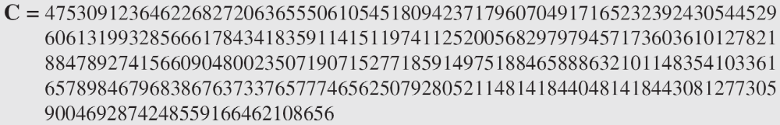
Example 30.9 (continued)
The ciphertext calculated by Alice is C = P^{e}, which is.
Bob can recover the plaintext from the ciphertext by using P = C^{d}, which is
The recovered plaintext is THIS IS A TEST after decoding.
30.<number>

Slide 56
Diffie-Hellman
RSA is a public-key cryptosystem that is often used to encrypt and decrypt symmetric keys.
Diffie-Hellman, on the other hand, was originally designed for key exchange.
In the Diffie-Hellman cryptosystem, two parties create a symmetric session key to exchange data without having to remember or store the key for future use.
They do not have to meet to agree on the key; it can be done through the Internet.
30.<number>

Slide 57
Diffie-Hellman
Let us see how the protocol works when Alice and Bob need a symmetric key to communicate.
Before establishing a symmetric key, the two parties need to choose two numbers p and g.
The first number, p, is a large prime number on the order of 300 decimal digits (1024 bits).
The second number is a random number.
These two numbers need not be confidential. They can be sent through the Internet; they can be public.
30.<number>

Slide 58
Diffie-Hellman
Step 1: Alice chooses a large random number x and calculates R1 = g^{x} mod p.
Step 2: Bob chooses another large random number y and calculates R2 = g^{y} mod p.
Step 3: Alice sends R1 to Bob. Note that Alice does not send the value of x; she sends only R1.
Step 4: Bob sends R2 to Alice. Again, note that Bob does not send the value of y, he sends only R2.
Step 5: Alice calculates K = (R2)^{x} mod p.
Step 6: Bob also calculates K = (R1)^{y} mod p.
The symmetric key for the session is K.
(g^{x} mod p)^{y} mod p = (g^{y} mod p)^{x} mod p = g^{xy} mod p
30.<number>

Slide 59
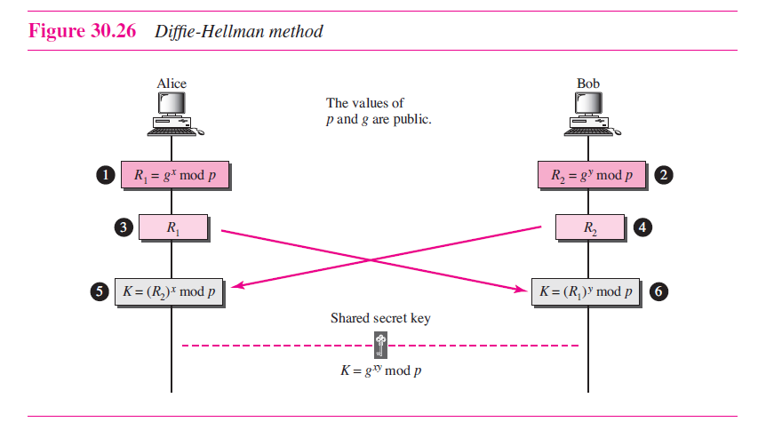
30.<number>

Slide 60
Diffie-Hellman
Bob has calculated
K = (R1)^{y} mod p = (g^{x} mod p)^{y} mod p = g^{xy} mod p.
Alice has calculated
K = (R2)^{x} mod p = (g^{y} mod p)^{x} mod = g^{xy} mod p.
Both have reached the same value without Bob knowing the value of x and without Alice knowing the value of y.
30.<number>

Slide 61
Note
The symmetric (shared) key in the
Diffie-Hellman protocol is
K = g^{xy} mod p.
30.<number>

Slide 62
Example 30.10
Let us give a trivial example to make the procedure clear. Our example uses small numbers, but note that in a real situation, the numbers are very large. Assume g = 7 and
p = 23. The steps are as follows:
1. Alice chooses x = 3 and calculates R₁ = 7³ mod 23 = 21.
2. Bob chooses y = 6 and calculates R₂ = 7⁶ mod 23 = 4.
3. Alice sends the number 21 to Bob.
4. Bob sends the number 4 to Alice.
5. Alice calculates the symmetric key K = 4³ mod 23 = 18.
6. Bob calculates the symmetric key K = 21⁶ mod 23 = 18.
The value of K is the same for both Alice and Bob;
g^{xy} mod p = 7¹⁸ mod 23 = 18.
30.<number>

Slide 63
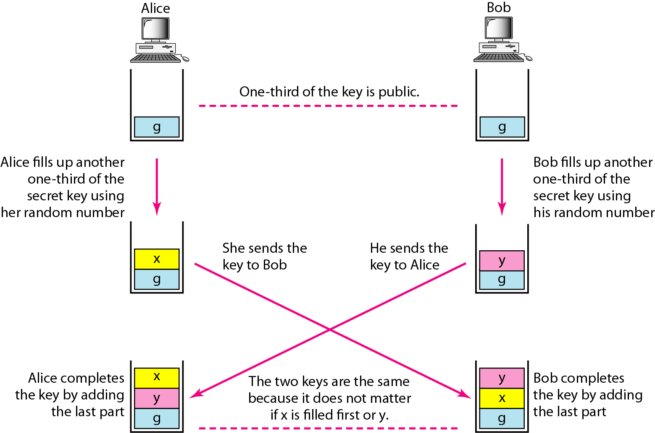
Figure 30.27 Diffie-Hellman idea
30.<number>

Slide 64
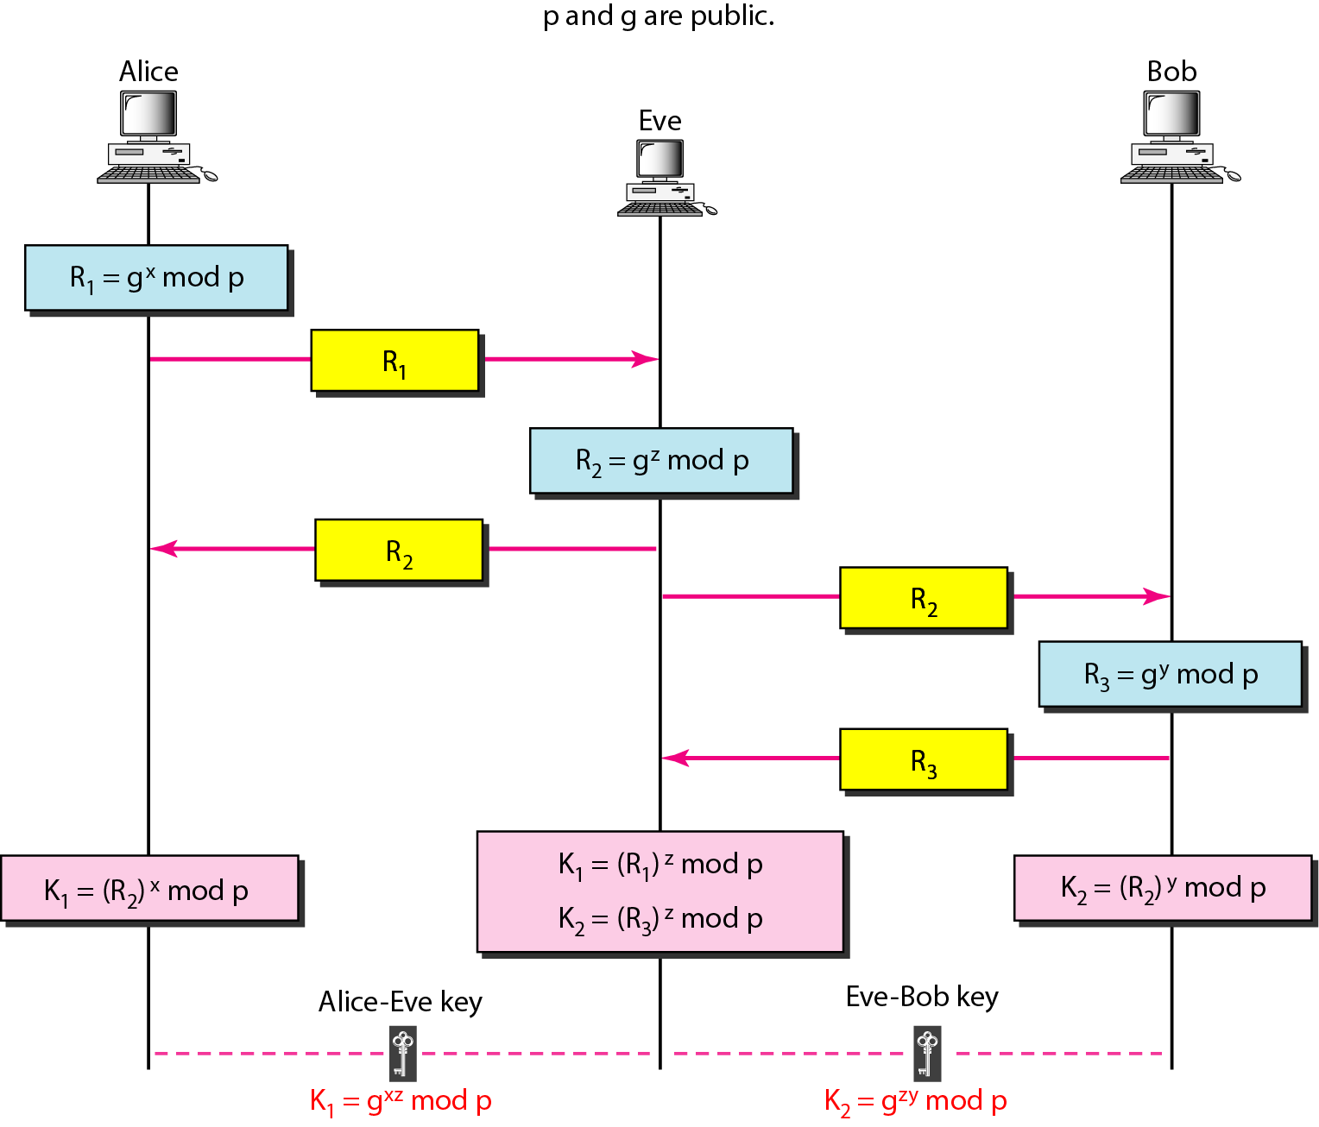
Figure 30.28 Man-in-the-middle attack
30.<number>

